Slide 1
Ideas, Beliefs, and Culture of the Modern Era
Meghan Bradley, Val Bogachev, Matt Franks, Dylan Peniston, Nuri Ha, and Mikaila Harper

Slide 2
Setting the Scene
The 1970s were a time of extreme change where standards were challenged, new interests were brought about, and the relationship between the government and the citizens was reshaped, all of these triggering differing reactions from society.
An increase in awareness involving homosexuality
Refining in the Government and individuals relationship
Liberalism versus traditionalism

Slide 3
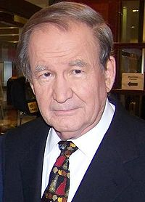
PAT BUCHANAN DECLARES “CULTURE WAR”
"There is a religious war going on in our country for the soul of America. It is a cultural war, as critical to the kind of nation we will one day be as was the Cold War itself."
-Pat Buchanan
Buchanan characterized the conflict as about power over society's definition of right and wrong. He named abortion, sexual orientation and popular culture as major fronts – and mentioned other controversies, including clashes over the Confederate Flag, Christmas and taxpayer-funded art.

Slide 4
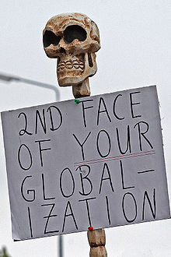
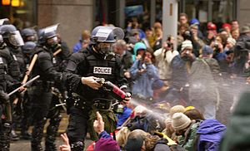
WTO PROTESTS
Global Trade Negotiations in 1999
40,000 protesters showed up
Protested globalization of companies and deregulation of markets

Slide 5
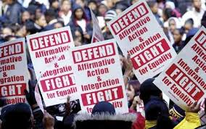
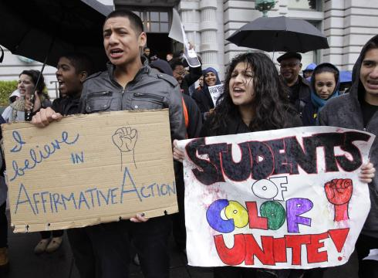
END OF AFFIRMATIVE ACTION
On November 5, 1996
Proposition 209 amended the California Constitution,
prohibiting affirmative action: the discrimination of people based on race, sex, ethnicity

Slide 6
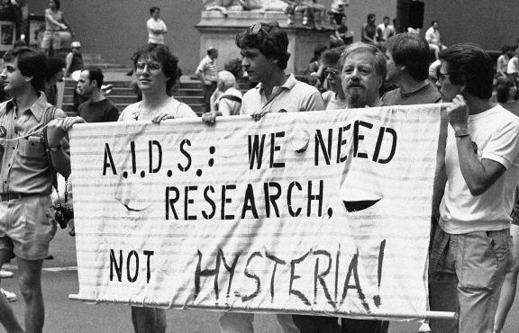
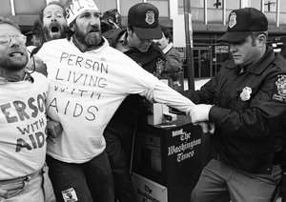
IMPACT OF AIDS
An increase in homosexual males becoming sick from rare forms of cancers and pneumonias lead doctors to discovering Acquired Immune Deficiency Syndrome (AIDS). Society began treating them like they had the plague, people wouldn’t hug or even touch those that were infected.

Slide 7
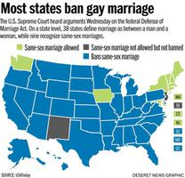
DEFENSE OF MARRIAGE ACT
In 1996 the U.S. Congress overwhelmingly passed (with the Bill Clinton’s signature) the Defense of Marriage Act defining marriage in federal law as only a legal union between one man and one woman as husband and wife, and the word "spouse" refers only to a person of the opposite sex who is a husband or a wife.

Slide 8
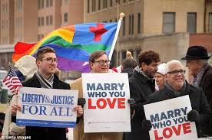
MASSACHUSETTS BECOMES THE FIRST STATE TO LEGALIZE SAME SEX MARRIAGE
On November 18 2003 Massachusetts’ Supreme Court
ruled that same sex marriage was unconstitutional.
Thousands of couples gathered for the stroke
of midnight when marriage
licenses would become available same
sex couples that had been together for years.

Slide 9
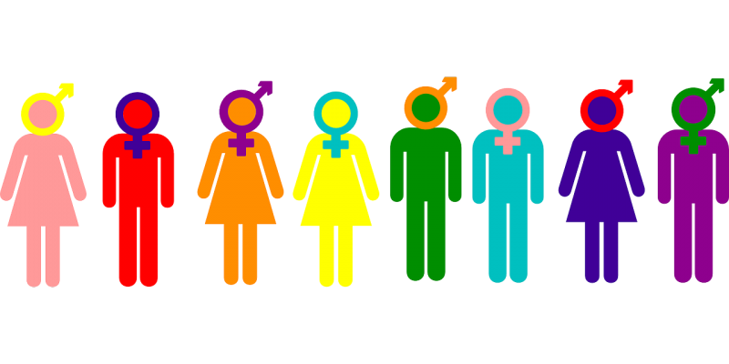
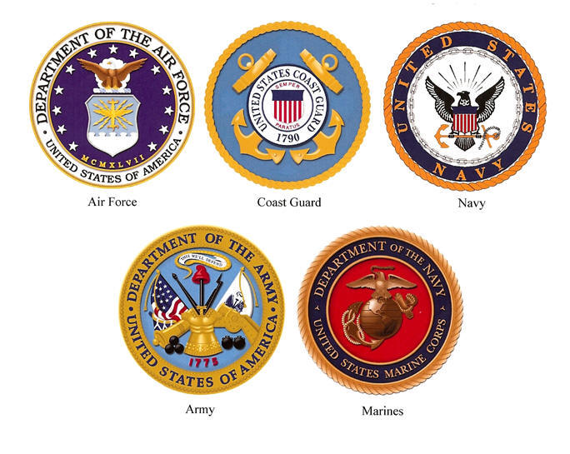
DONT ASK DONT TELL
President Obama enacted the Don’t Ask Don’t Tell Repeal Act of 2010
in December 2010 to gradually allow openly gay, lesbian, and bisexual people
to serve in the United States Armed Forces.

Slide 10
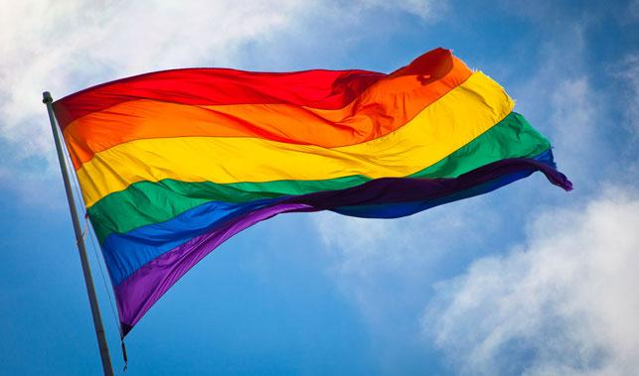
LAWRENCE VS TEXAS
Landmark Supreme Court Decision in 2003
Overturned Bowers v. Hardwick
Made same-sex sexual activity legal

Slide 11
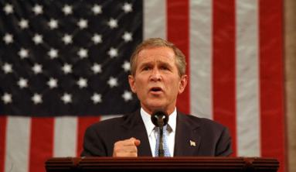
“War on Terror”
Following the September 11, 2001 attacks
Strengthened relationship between the government and the citizens
Shift from inclusiveness to distanced with other countries
Protect the nation
New military operations, security legislation, efforts to block the financing of terrorism
“You are either with us or against us” -George W Bush

Slide 12
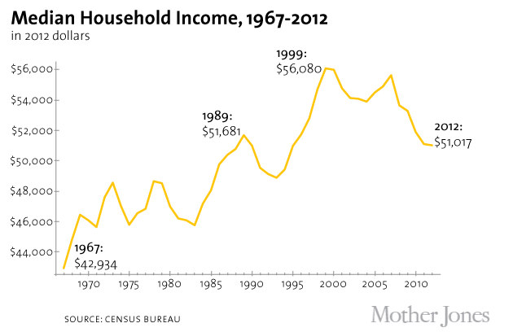
RENEWED EMPHASIS ON MATERIAL SUCCESS
In the 1980s, all aspects of popular culture revolved around the celebration of moneymaking. The upper class and lower class was rising while the middle class was shrinking. The average wealth of the fortune 500’s rose from $230 million to $682 million.

Slide 13
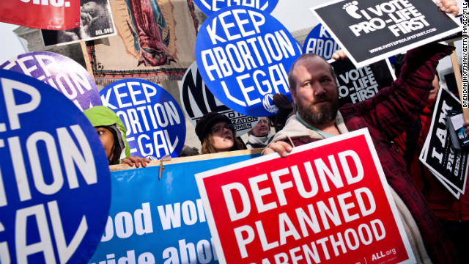
WEBSTER V REPRODUCTIVE HEALTH SERVICES
A United States Supreme Court decision on July 3, 1989 upholding a Missouri law that imposed restrictions on the use of state funds, facilities, and employees in performing, assisting with, or counseling on abortions.

Slide 14
Conclusion
The centralized theme of Ideas, Beliefs, and Culture of the Modern Era is:
Progression and regression depending on the differing viewpoints
Conservatism and Liberalism created two differing viewpoints on the prominent social issues in America at the time.
An increase in discussion regarding homosexuality led to progression in the eyes of the liberals however the conservative association with relgion viewed homosexualtiy as wrong.
The refining of the relationship between government and individual swayed more towards conservative favor, however taboo national discussion involving abortion also forwarded the liberal agenda.

